Slide 1
Scalability with many lights II
(row-column sampling, visibity clustering)
Miloš Hašan

Slide 2
Scalability with Many VPLs
Alternatives to lightcuts
  Matrix row-column sampling
  Visibility clustering
Potential advantages
  Shadow mapping instead of ray tracing
  Simpler to implement
  No bounds on BRDFs required
  Faster in occluded environments
Notes:
In this part of the course, I will talk about several techniques that improve the scalability of many-light methods with the number of virtual lights. In other words – we have reduced our rendering problem to computing the connections between many VPLs and many receivers, or “gather points”.
Of course, one way to do it are the lightcuts algorithms that Bruce described, which are very reliable ad high-quality. I will introduce alternative techniques like row-column sampling and visibility clustering, which can have some other advantages.
For example, one may be able ot use shadow maps instead of ray casting for visibility checking, which tends to be faster in most cases. No bounds on shders are required, which can lead to simpler implementations. There may also be advantages in highly occluded environments, where lightcuts will conservatively evaluate illumination assuming full visibility.

Slide 3
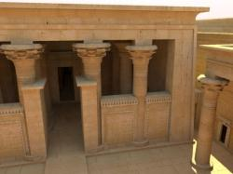
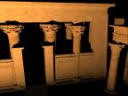
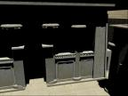
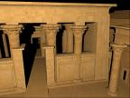
A Matrix Interpretation
Lights (100,000)
Pixels
(2,000,000)
Notes:
To get started in describing the algorithms, we first need to interpret the many light problem as a matrix of light-pixel interactions. This means that each element of the matrix is the contribution of a single light to a single pixel.
So, the columns of the matrix are really images rendered with a single point light.
The rows represent contributions of all the lights to a particular pixel.

Slide 4
Problem Statement
Compute sum of columns
Note: We only have oracle A(i,j)
Lights
= Σ (
)
Pixels
Notes:
In this setting, the ideal image we would like to render is equal to the sum of the columns of the matrix.
Or, to put it differently, the color of each pixel is equal to the sum of the matrix row corresponding to that pixel.
It is important to note that we’re not given the matrix data, we just have an “oracle” – a function that can evaluate the elements on demand. Our goal is to compute the sum without evaluating most of the elements. How is this even possible?

Slide 5
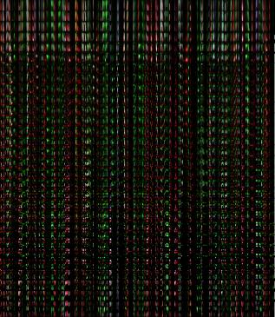
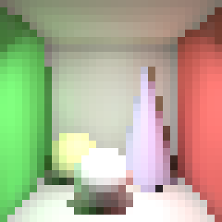
Matrix has structure
643 lights
900 pixels
A simple scene
30 x 30 image
The matrix
Notes:
The trick is that the matrix is highly structured. Here is an example with a Cornell box. with a single direct light, and Numerically, the matrix often close to low-rank: its columns can often be approximated by linear combinations of other columns.
Therefore, we can get away with computing only a very small subset of the elements, and still gather enough information to render an accurate image.

Slide 6
Low Rank Assumption Violation
…
Bad case: lights with very local contribution
Notes:
Of course, the low rank assumption is not always valid – here is an example of a really bad case, where the light’s contributions are linearly independent. Fortunately, this does not happen in practice that often.
6

Slide 7
Sampling Pattern Matters
Lights
Pixels
Point-to-point visibility: Ray-tracing
Point-to-many-points visibility: Shadow-mapping
Notes:
So, we want to sample a subset of the matrix elements, but which ones should we choose?
If we sample complete rows and columns, we can use GPU shadow mapping as our visibility algorithm. This way we can compute elements at very high rate. Futhermore, it is easier to reason about rows and columns, so even if we use a ray-tracer, it may still be an advantage to sample like this.

Slide 8
Row-Column Shadow Duality
Columns: Regular Shadow Mapping
Rows: Also Shadow Mapping!
Shadow map at light position
Shadow map at sample position
Surface samples
Notes:
One may wonder how to compute the row contributions using shadow mapping. After all, shadows normally come from the light!
However, shadow mapping is simply a way to determine the visibility from a point to many other points at once.
We can compute a cube shadow map at the VPL position, and determine the visibility of the surface samples, as usual. Or, we can compute the cube at the receiver position, and query the light positions against it.
However, if you’re implementing any of these algorithms, I would recommend to debug with ray-traced occlusion first.

Slide 9

Exploration and Exploitation
?
how to choose columns and weights?
compute rows (explore)
compute columns (exploit)
weighted sum
Notes:
OK, we know how to compute rows and columns. How do we design the rest of the algorithm based on them? We use an idea that combines exploration and exploitation.
As a first step, we explore the structure of the matrix by computing a small, randomly chosen subset of rows.
Next, we analyze the gathered information, and decide which columns to choose and their appropriate weights.
The exploitation step then computes the selected columns, which are finally accumulated into an image.
The only thing missing I the contents of the black box that analyzes the rows and chooses the columns.

Slide 10



Reduced Matrix
Reduced columns
Notes:
To understand this, let’s take the rows that we computed in the exploration stage,
And assemble them into this long, but not very tall reduced matrix.
Now let’s flip attention to the columns of this matrix, which we’ll call reduced columns.
These can in fact be thought of as tiny images that are sub-sampled versions of the full columns.

Slide 11
Clustering Approach
Choose representative columns
Reduced columns
Choose k clusters
Notes:
We will use a clustering approach to choosing columns: we cluster similar reduced columns, and we pick a representative in each cluster. Of course, we can arbitrarily re-shuffle the columns – there’s no such thing as “neighboring columns”.
Note that this is actually an unbiased Monte Carlo estimator: each representative, if properly weighted, computed an unbiased estimate of its own cluster. So the whole algorithm is an unbiased estimator of the sum of all lights.
The accuracy of the algorithm is highly dependent on the quality of the clustering, so we should design it carefully.

Slide 12
Visualizing the Reduced Columns
Reduced columns: vectors in high-dimensional space
visualize as …
radius = norm
Notes:
First, let’s think about the reduced columns as vectors in a high-dimensional space.
We’re going to visualize these high-dimensional vectors as circles.
The radius of each circle will correspond to the norm of the reduced column, or equivalently, to the brightness of the little image.
The positions will correspond to the positions of normalized reduced columns in the high-dimensional space.
With a bit of simplification, we can say that circles that are close to each other represent similar lights, and large circles represent lights with strong intensity.

Slide 13
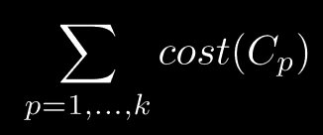
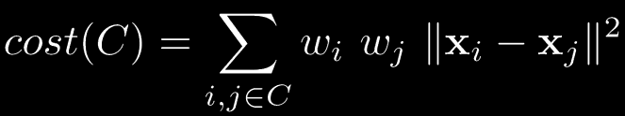
The Clustering Metric
Minimize:
where:
total cost of all clusters
norms of the reduced columns
squared distance between normalized reduced columns
cost of a cluster
sum over all pairs in it
Notes:
We can prove that the following formula gives the optimal clustering that minimizes the expected error.
So let’s look at its meaning. We’re minimizing the sum of costs of all clusters,
Where the cost of a cluster is defined as the sum over all pairs of elements in the cluster
of the product of norms and squared distance.
This confirms the intuition that strong lights, or lights that are far from each other, should be in separate clusters.

Slide 14
Clustering by Divide & Conquer
Notes:
This is an NP-hard problem, but a good approximation can be found by the following divide & conquer algorithm.
We pick a plane with a random orientation. Remember this is in many dimensions, here I’ll just visualize it as a line.
Then we move the plane to its optimal position and split the points into two clusters. There are only n possibilities so we can check them all to find the best one.
We then continue this process recursively on the cluster with the currently highest cost.

Slide 15

Full Algorithm
Assemble rows into reduced matrix
Cluster reduced columns
Compute rows (GPU)
Choose representatives
Weighted sum
Compute columns (GPU)
Notes:
To summarize, here’s the full algorithm:
In the exploration stage, we evaluate some rows on the GPU, then focus on the reduced columns.
We obtain a clustering through the techniques I just described, then pick representatives.
Finally, we accumulate the corresponding columns with the correct weights into an image.
Let’s not lose the big picture: all of this is an abstraction that lets us increase the scalability of an underlying many-light algorithm.

Slide 16
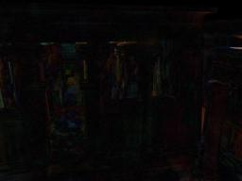


Results: Temple
2.1m polygons
Mostly indirect & sky illumination
Indirect shadows
5x diff
Our result: 16.9 sec (300 rows + 900 columns)
Reference: 20 min (using all 100k lights)
Notes:
The temple is quite a large scene, not only in terms of the number of polygons, but also its spatial extent. In fact, only a tiny portion of the scene is in view. Most of the illumination in the scene is indirect or sky illumination, with the only pixels lit directly by the sun form the small bright patches on the right.
The method can quite effectively pick the small subset of VPLs that captures the illumination. Many VPLs are either invisible or have a small contribution, and can be aggressively clustered.

Slide 17
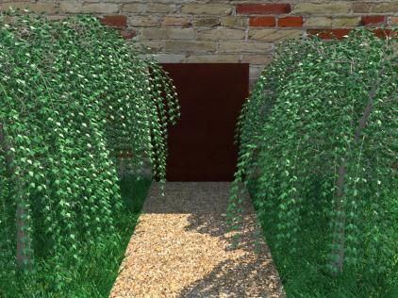

Results: Trees and Bunny
Complex incoherent geometry
Low rank, not low frequency
Our result: 2.9 sec (100 rows + 200 columns)
Our result: 3.8 sec (100 rows + 200 columns)
Notes:
These scenes are designed to test the algorithm by complex incoherent geometry, and it works quite welll.
Approaches based on interpolating illumination across coherent surfaces would have a difficult time rendering these images.
However, our algorithm makes no assumptions about image-space coherence. In this sense, low-rank light transport can be a better approximation than smooth, low-frequency irradiance.

Slide 18
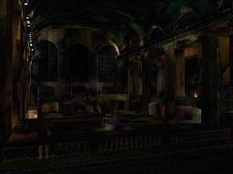
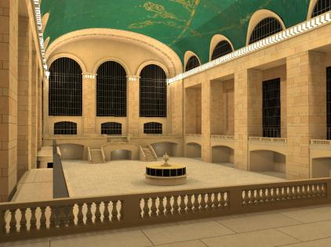

Results: Grand Central
1.5m polygons
Point lights between stone blocks
5x diff
Our result: 24.2 sec (588 rows + 1176 columns)
Reference: 44 min (using all 100k lights)
Notes:
This scene, the Grand Central station, is a bit of a difficult case. A unique feature of the scene are the omni-directional lights positioned in small recesses between stone blocks.
These lights pose a problem since they violate the low-rank assumption. The columns corresponding to these lights are pretty much linearly independent. Therefore, a larger number of rows and columns will be required here, and some lights are still missing on the left side.

Slide 19

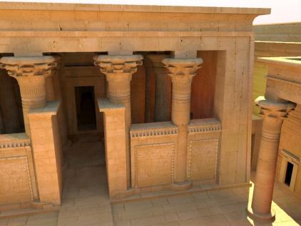
Advantage: Adaptive Stratification
Our result
(432 rows + 864 columns)
Importance sampling
(Using 1455 lights)
Equal time comparison
Notes:
An important question is whether the row sampling step of our algorithm is more useful than brute force.
Indeed, instead of creating 100,000 lights and trying to pick a small subset of them, we could simply create a smaller number of lights and render them all.
However, if we compare these images, we find that the simpler approach produces much more objectionable artifacts despite taking a bit longer.

Slide 20
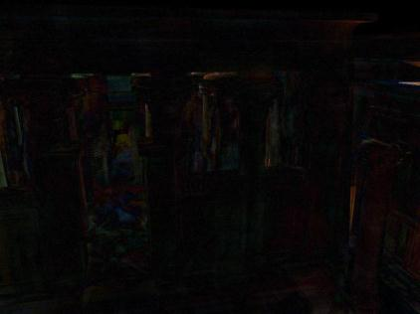
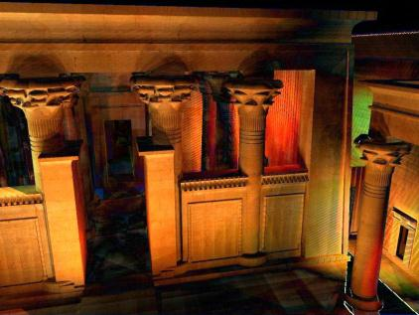
Advantage: Adaptive Stratification
Our result
Importance sampling
Equal time comparison: 5x difference from reference
Notes:
Here are difference images as well.

Slide 21
Animations: Tensor Extension
Lights
Lights
Frames
Frames
Pixels
Pixels
Sequence of matrices
Tensor view
Size of tensor in our results: 307,200 x 65,536 x 40
Notes:
In row-column sampling, we had a different matrix in every frame. Let’s concatenate them,
and consider all of them at once as one large 3D array (or tensor) of lights contributing to pixels over frames.
The amount of data is very large, and we need to avoid constructing the whole tensor at any point in the algorithm, similar to the matrix case.

Slide 22
Tensor Extension - Overview
Sample slices
Reduced tensor
Cluster reduced columns
Compute representatives
Reconstruct full tensor
Rectangular clustering
Notes:
The extension will be done as follows: We compute a set of rows in every frame, resulting in a set of horizontal slices of the tensor.
Then we cluster the columns of this reduced tensor; I call this a “rectangular clustering” since every cluster is a cartesian product of a light subset and a frame subset.
We can then use a similar representative selection and reconstruction as before, except here we have to be careful, because pixels move between frames. A pixel mapping trick similar to optical can be used to warp the representatives to avoid this problem.

Slide 23
Splitting a cluster
Pick cluster with highest cost
Try splitting in time
Try splitting in lights
Pick better alternative
Time split
Lights
Frames
Light split
Notes:
How do we find a rectangular clustering? This problem is again NP-hard, but we can adapt the divide-and-conquer as follows.
We will start with all light-frame pairs in one cluster, and keep splitting the cluster with highest cost until we reach the desired number of clusters.
We will try splitting the cluster in time and in lights, and pick the split that gives us the better objective function value.
Now the question is, how to split in time and in lights; we can answer this by trying both splits and seeing which one decreases the objective function more.

Slide 24
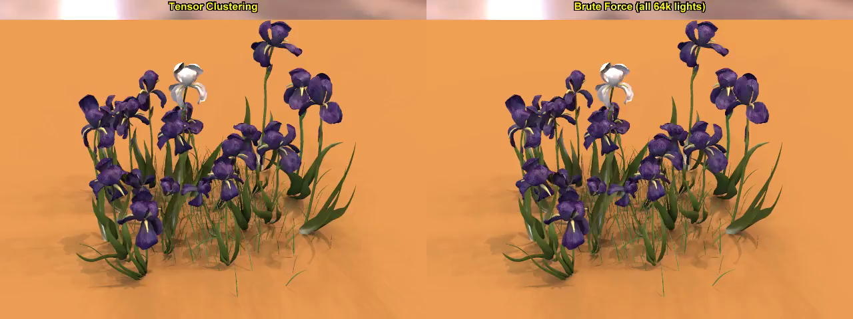
Results - Iris
51k triangles, 65,536 lights
Deforming objects, high-frequency shadows
6.9 sec / frame (brute-force: 2 min / frame)
Notes:
Here is an example animation rendered with this method. On the left is the result, and on the right is reference with all VPLs, which took about 9 times longer.

Slide 25
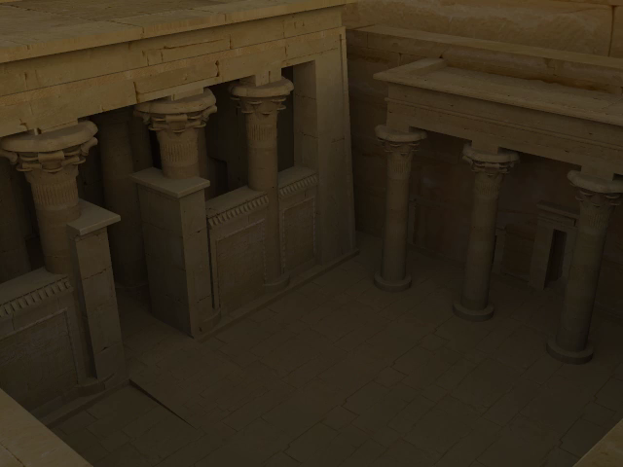
Results - Temple
2.1m triangles, 65,536 lights
Sun & sky lighting, moving sun
Multiple indirect light bounces
26 sec / frame (brute-force: 33.5 min / frame)
Notes:
And here is another example with a temple and a moving sun. This one is about 77x faster than the brute-force solution.

Slide 26
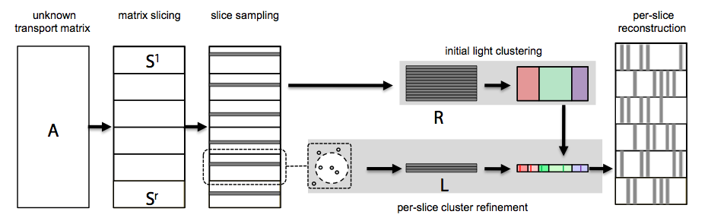
LightSlice [Ou and Pellacini 2011]
Compute initial clustering
Refine it differently in different “slices”
Use neighboring slices to get more rows
Notes:
Another nice idea, published recently in the LightSlice paper, is to refine the original clustering within “slices” of the image.
One problem is that each slice will only have one row sample, and one-dimensional data is not enough to run a clustering algorithm. This is addressed by using neighboring row samples to help.

Slide 27
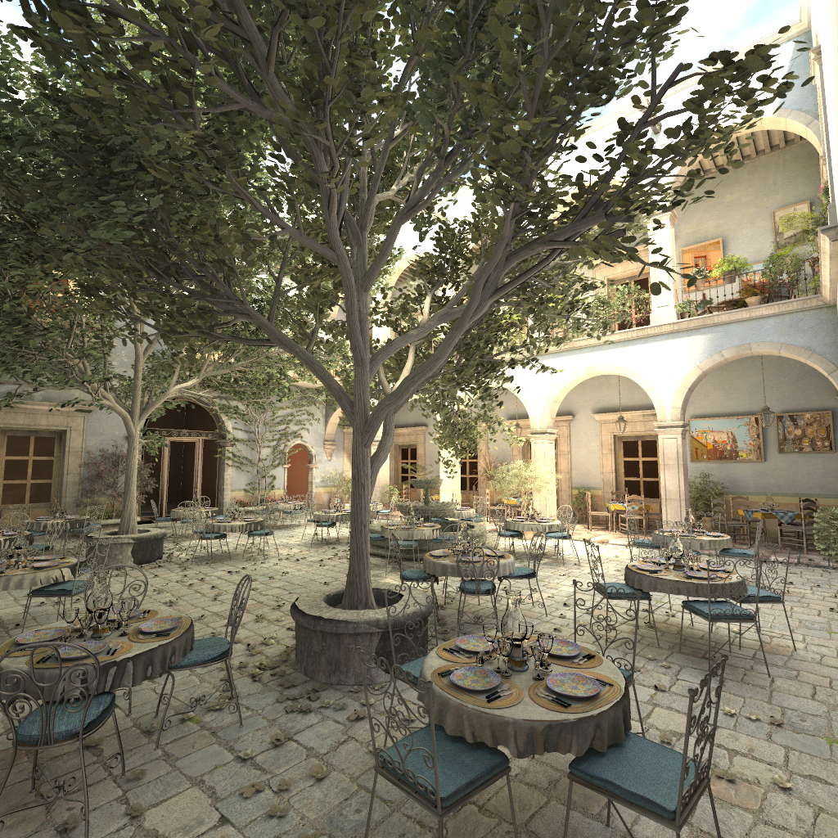
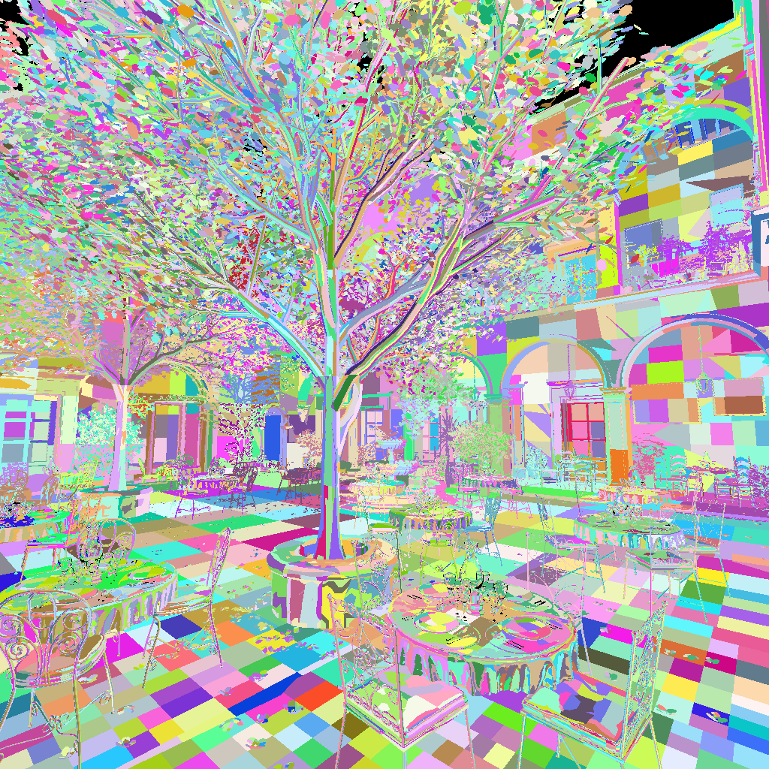
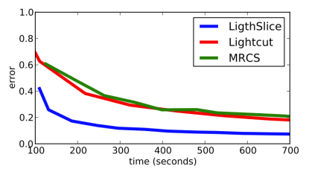
LightSlice: Results
Notes:
This works very well - in fact, on this fairly complex scene, the algorithm seemsto outperform both lightcuts and row-column sampling.

Slide 28
Visibility Clustering [Davidovič et al 2010]
Lights
Separate shading from visibility
Cluster only visibility
Shade from all VPLs
shading (all VPLs)
visibility
(representatives)
Notes:
Next, I will introduce an interesting variation of the row-column approach that is some cases more robust.
The design of the algorithm is motivated by several observation on shading and visibility in glossy scenes.
First, we observe that in glossy scenes we cannot easily pick a small subset lights to approximate the solution, because shading from the individual lights is quite different. In other words, we want to compute the shading from all the global VPLs. And that’s actually doable because the GPU is extremely efficient at computing the shading.
But we just cannot afford to evaluate a SM for each of those 200k lights! So the key insight is to separate shading from visibility, use ALL the light for shading, and only a small number of representative lights for visibility.

Slide 29

Visibility Clustering Overview
Row
sampling
Reduced
matrix
VPL tracing
shading
visibility
Visibility
clustering
Render lights with
reps’ visibility
Result
Notes:
Here’s the overview of visibilty clustering. We start by distributing the global VPLs in the scene by tracing particles frOm light sources.
After that, we sample a number of rows of the interaction matrix, which means that we pick a number of pixels and for each of them, we evaluate the shading and visibility for all the lights. That gives us the reduced shading and visibility matrices.
The visibility clustering then analyzes these matrices and yields clusters of lights that will share the same shadow map. After that, we render all the VPLs with the shadow map of the representative light for each cluster. This yields the complete global solution.
There’s only one bit that remains to be explained here, and that’s the visibility clustering algorithm.

Slide 30
Visibility clustering
Clustering algorithm
  Divide & conquer (top-down splitting)
  Modified clustering cost
    L2 error of reduced matrix due to visibility approximation
clusters
shading
visibility
representatives
Notes:
The goal of the visibility clustering algorithm is to group VPLs into clusters that will share the shadow map of its representative VPL. We use a data-driven approach where we analyze the row samples from the light interaction matrix.
The clustering algorithms proceeds in a top-down fashion, splitting clusters with highest cost, which is defined as the L2 error of the matrix incurred by the visibility approximation.

Slide 31
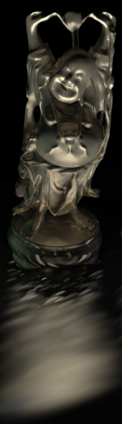
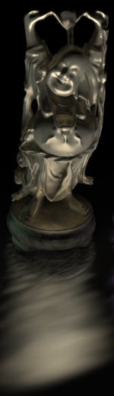
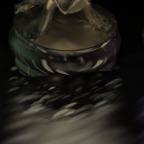
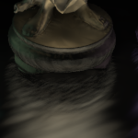
Visibility clustering result
Matrix row-column sampling
Our visibility
clustering
10k shadow maps
10k shading lights
5k shadow maps
200k shading lights
Notes:
Here’s a comparison of the result of our visibility clustering with MRCS in the same time for a simple scene of the happy Buddha statue reflected in a glossy plane. The MRCS result uses 10k representative lights (i.e. 10k shadow maps and 10k lights for shading), which leaves visible splotches in the image. The visibility clustering, in the other hand, uses only 5k shadow maps for visibility but all the 200k lights for shading, substantially improving the smoothness of the reflections.

Slide 32
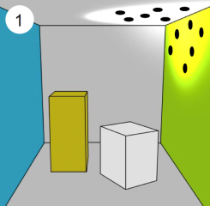
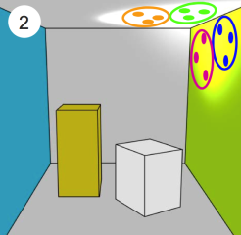
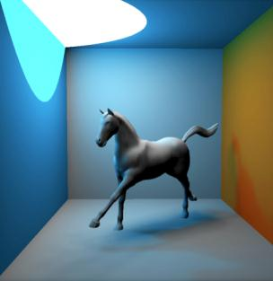
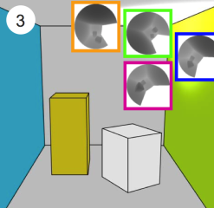
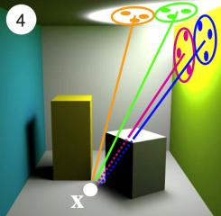
Clustered Visibility [Dong et al 2009]
Trace VPLs
K-means clustering
Real-time diffuse indirect illumination
Soft shadow maps
Compute full shading
Notes:
Another alternative approach I should mention uses no matrix formulations, but instead uses a simple visibility clustering idea that nevertheless works well in simple scenes and can even achieve real-time performance.
The idea is to use k-means clustering for visibility, and render full shading. One may think that this for highly variable VPL intensities, but for a single bounce, and one lightsource, one can easily make all VPLs same intensity. The approach also uses soft shadow maps, so it can get away with pretty small numbers of shadow maps.

Slide 33
Conclusion
Row-column sampling algorithms
  Handle large numbers of VPLs
  Alternatives to lightcuts
Open Problems
  How many rows + columns?
    Pick automatically
  Row / column alternation
  Progressive algorithm:
    stop when user likes the image
Notes:
Here are some of the open problems in this area. How to pick the number of rows and columns automatically?
It would be nice to design a variation of the algorithm that alternates row and column sampling, since knowing some columns might tell us which rows to sample, but no one seeknows how to do it.
It might also be useful to make the algorithm progressive, so the user can stop the evaluation when they are satisfied with the image.
A temporal version of the technique that renders multiple frames at once would be great. The problem is – how to do it so that the representatives do not have to be kept in memory?
Finally, there are some other approaches for matrix completion in the literature, but we tried them for rendering and they did not turn out to be better. However, there might be ways to improve them, they just haven’t been studied systematically.

